Slide 1
variety and fragmentation in Higher education research
department of sociology
Centre for higher education governance Ghent (CHEGG)
Jeroen Huisman, 14 March 2023, Centre for Higher Education Transformations, Bristol

Slide 2
A “MATURE” FIELD?
Growing field (but what about other fields …)
Increasing attention to stock-taking, meta-reviews, systematic literature reviews => signs of reflective stance and … maturity?
Yes, but it remains a “field”, not a discipline (but see Tight, 2021, TEAM)
Yes, but concerns about fragmentation

Slide 3
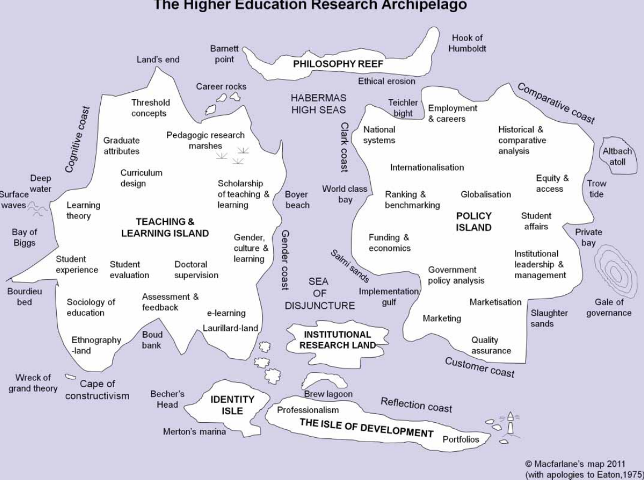
Map of Higher Education

Slide 4
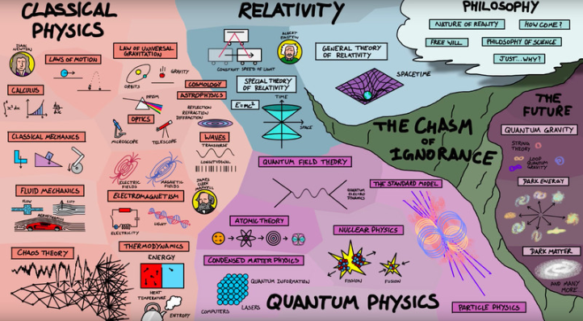
Map of Physics

Slide 5
Variety and fragmentation
Agreement on variety
Fragmentation? the jury is out there:
♦ it may be largely “natural” and functional, e.g. micro-meso-macro-nature
of the field, diversity of types of researchers (Teichler, 2000, chapter
Schwarz & Teichler)
♦ … or is it problematic?

Slide 6
General perspectives
♦ many normative perspectives on this matter
♦ others are somewhat naïve: growth = progress
♦ big Q: how can we unpack variety, growth, progress?
♦ two examples, papers in Higher Education:
Daenekindt & Huisman
Vlegels & Huisman

Slide 7
Daenekindt & huisman
17,000 abstracts of articles in WoS in 28 HE journals, 1991-2018
Topic modelling: themes, patterns
Descriptives:
Topics across three levels: individual (16 topics), organisations (5), systems (3), additionally: discipline (5) + method/ethics (2)
Ex. Subthemes at organisation level:

Slide 8
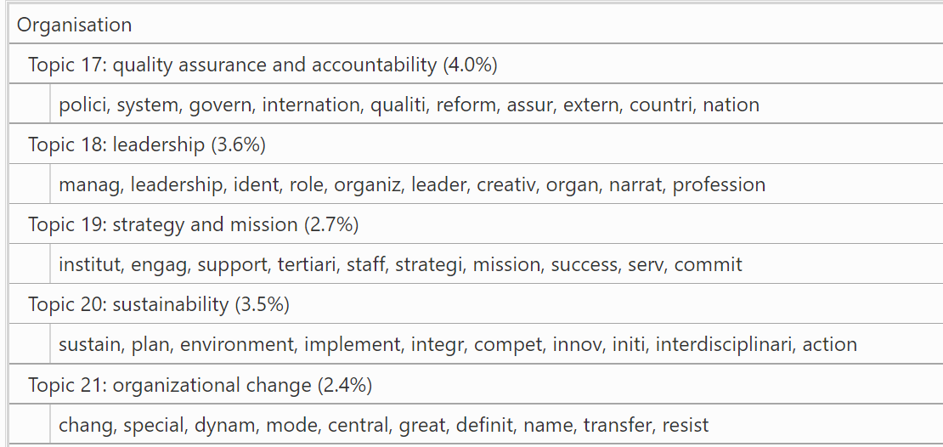
Examples of topics

Slide 9
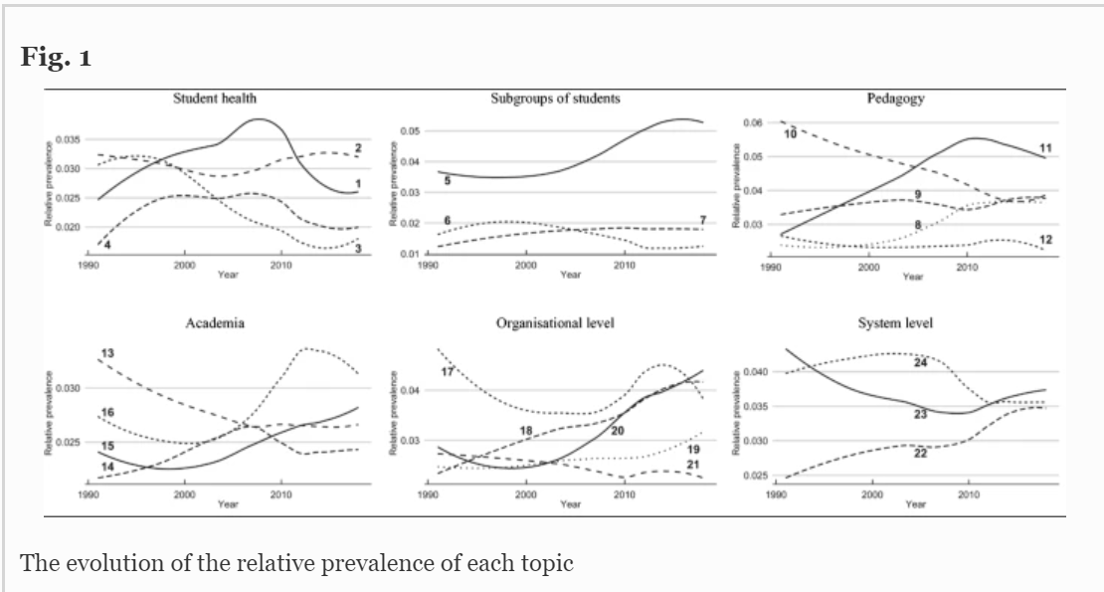
TOPICS OVER TIME
Analysis: Topics and subthemes wax and wane over time

Slide 10
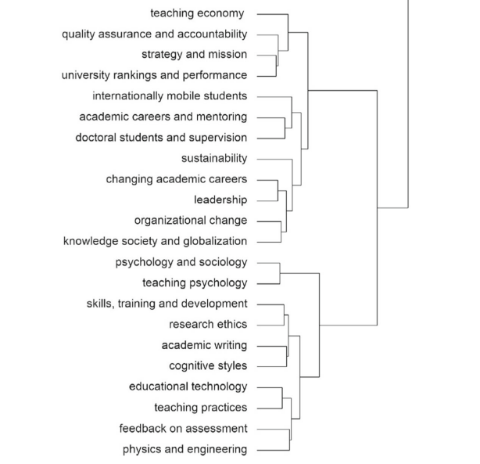
Variety or fragmentation
Analysis: Clustering of topics
and subthemes

Slide 11
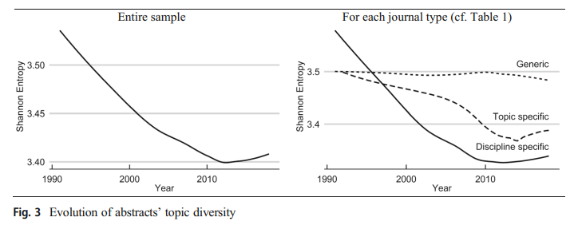
TOPIC diversity
Analysis: diversity

Slide 12
Conclusions (D&H paper)
Less diversity over time: trend towards topic specialization. Possibly maturity …
… but more likely fragmentation: subthemes “not talking to each other”

Slide 13
VLEGELS & Huisman
Network structure of our field (co-author patterns), 28 HE journals, WoS, 1976-2018
- Co-author patterns = collaborative efforts
First network characteristic:
(1) Smallworldness: internally connected clusters, but less well-connected to other clusters.

Slide 14
VLEGELS & Huisman
Cliques are not necessarily problematic! But well-connected clusters are important for innovation and knowledge dissemination

Slide 15
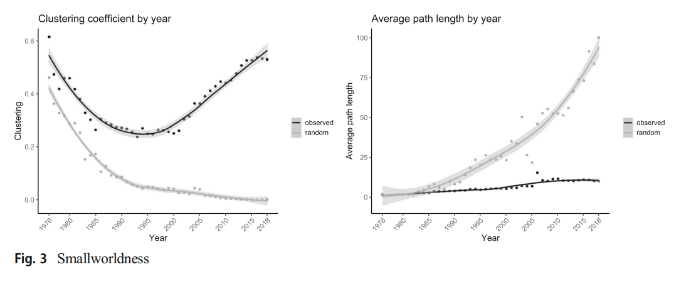
Smallworldness
“Small worlds, but connected”

Slide 16
VLEGELS & Huisman
Second network characteristic:
(2) Preferential attachment: popular nodes attractive for future cooperation. (But) may also be sign of (in)equality => Matthew effect

Slide 17
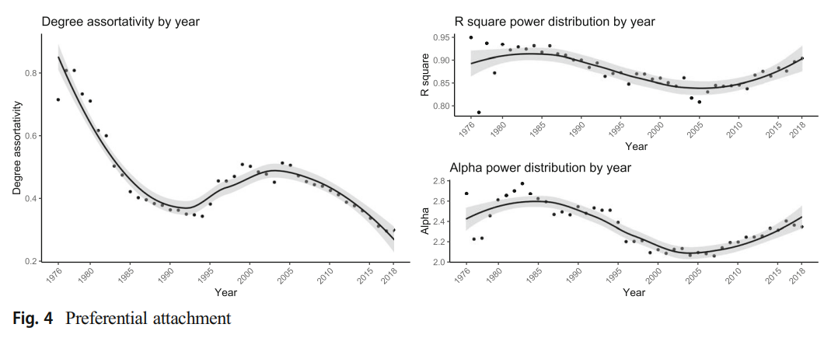
Preferential attachment
“Establishing co-author networks is highly selective”

Slide 18
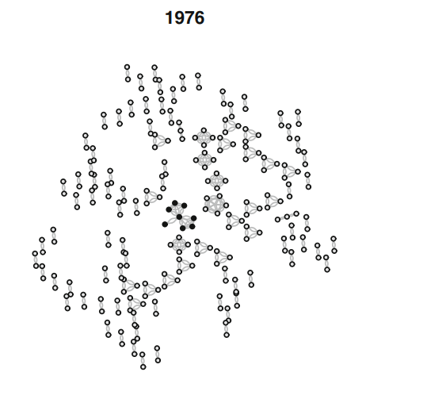
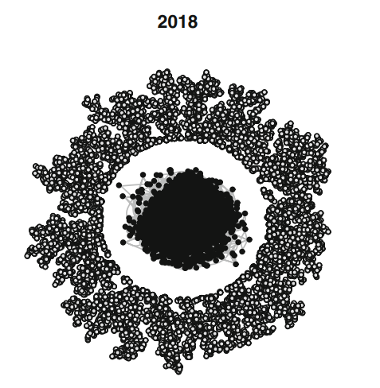
FRAgmentation
“Evolution towards core and periphery model”

Slide 19
CONCLUSIONs (V&H paper)
- Decreasing impact (citations drop over time)
“Balanced” smallworldness
Overshadowed by inequalities (preferential attachment) and
fragmentation

Slide 20
OVERALL CONCLUSION 1
Field of higher education is “maturing”: more journals, more researchers, more interest from policy-makers in higher education (but not necessarily in findings from higher education research), more stocktaking papers.
Implicit message in much stocktaking research: we are “doing okay”

Slide 21
OVERALL CONCLUSION 2
But:
(a) It looks like there are still many different churches with their own gospels,
some lenient, but many hardliners: inequality
(b) it looks like these communities are ignoring each other (“not
bothered”), NB: our research does not address the WHY question
(motivations of researchers)
(c) as a consequence: limited debate and opportunities for synergy and cross-
fertilisation

Slide 22
Suggestions
Radical solution: abolish higher education studies …
But, more seriously, connect (better) to the disciplines
Conferences and other network activities are important: should be organised in a much more “open” way
Be bold: do reach out to the “popular nodes”, but it takes two to tango …
Funders can set up targeted research programmes, but ultimately intrinsic motivation is a better guide ….
ANY OTHER SUGGESTIONS?

Slide 23
Thank You

Slide 24
centre for higher education governance ghent (CHEGG) E Jeroen.huisman@ugent.be www.ugent.be www.chegg.ugent.be
Ghent University @ugent Ghent University

